Slide 1

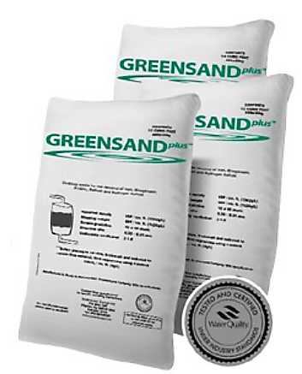
The Inversand Company - Supplying Greensand products since 1925
WQA Gold Seal Certification for NSF/ANSI 61 Compliance
Removes Iron, Manganese, Arsenic, Radium and Hydrogen Sulfide
GreensandPlus is a direct replacement for the original Manganese Greensand
Packaged in ½ Cu.ft bag or 1metric ton (2,205lbs) bulk sack

Slide 2
Internationally Accepted
Tried & Proven Choice that’s just right!
Not Too Coarse – Providing better trapping of colloidal material than coarse media
Not Too Fine – Providing excellent balance of run times between backwashes
Not Too Heavy – Minimizes backwash flow rates and waste volumes
Not Too Light - Providing excellent separation between media and filtered contaminants to eliminate media loss during backwash

Slide 3
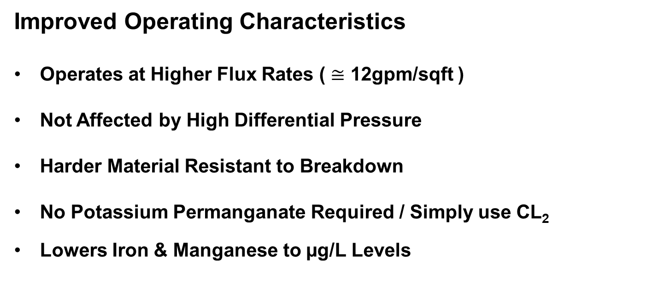
Improved Operating Characteristics
Operates at Higher Flux Rates ( $≅$ 12gpm/sqft )
Not Affected by High Differential Pressure
Harder Material Resistant to Breakdown
No Potassium Permanganate Required / Simply use CL₂
Lowers Iron & Manganese to µg/L Levels

Slide 4
Media Properties
GreensandPlus media consists of a solid silca sand core with thermally bonded coating of manganese dioxide.
Effective at higher differential pressures than standard manganese greensand that can fracture. Tolerance to higher DP can provide longer runtimes between backwash cycles.
Effective at higher temperatures with lower apparent density (88lbs/cuft) the backwash flow requirements are less. (10-12gpm/sqft)
Effective Size 0.30mm – 0.35mm / Uniformity Coefficient (UC)= Less than 1.6
Capacity: 700 – 1200 grains
Service Flow Rates = 2.0 – 12.0 GPM

Slide 5
Loading & Conditioning
Follow filter manufacturers loading instructions of all media.
After loading support gravel layers, backwash gravel at ½ normal flow rate then load GreensandPlus.
GreensandPlus must be backwashed and the fines removed prior to loading Anthracite layer.
GreensandPlus must be conditioned with oxidant prior to being placed into service.

Slide 6
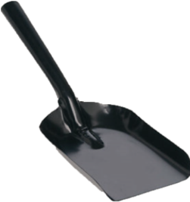
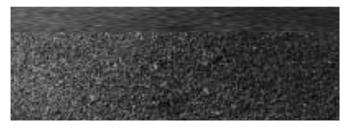
Fines removal process
After backwashing GreensandPlus for 30min. at normal flow rates the fines must be removed.
Using a flat blade shovel remove the top ½”-1” layer of fines. Do Not Scrape or Rake the top layer of fines.
This process must be completed before Anthracite is loaded if being used in the filter system.
Fines
GreensandPlus Media

Slide 7
Conditioning Process
Chemical Dosages:
Every 100 cubic feet of Greensand or GreensandPlus requires:
20 gallons of 15% bleach, or
50 gallons of 6% bleach, or
11.5 gallons of Carusol 20*, or
6 gallons of Carusol 40*, or
25 pounds of potassium permanganate dissolved in 100 gallons of water.
* Carusol-20 and Carusol-40 are liquid sodium permanganate products produced by Carus Chemical.
*Media should soak in conditioning solution for a minimum of 4hrs, if possible overnight.

Slide 8
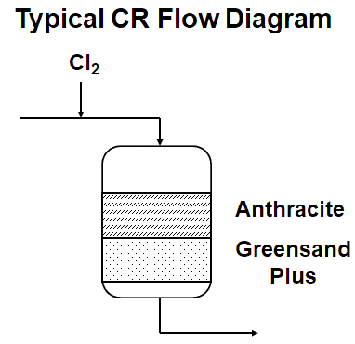
Method of Operation (CO)
Catalytic Oxidation operation is recommended in applications where Iron removal is the main objective in well waters with/without presence of Manganese.
Catalytic Oxidation requires the feeding of a predetermined amount of oxidant in the raw water before the filter with a contact time of 10-20 seconds or as far upstream of the filter as possible.
A free chlorine residual of 0.5 – 1ppm carried through
the filter will maintain GreensandPlus in a continuously
regenerated condition.
When using chlorine as the oxidant, the demand
can be estimated as follows: mg/L of Cl₂=
[Fe(mg/L) x 1] + [Mn (mg/L x 3] + [H2S (mg/L x 6] + [ NH3 (mg/L x 8) + [ 1 (mg/L)]

Slide 9
Suggested Operating Conditions
Bed Type: Dual Media / Anthracite Cap 15” – 18” (381 – 457mm)
  GreensandPlus 15” – 24” (381 – 610mm)
Flow Rate: Continuous Oxidation operation ( 2 – 12gpm/sqft*)
(* Contaminant concentration determines flow rates)
Contaminant Loading Calculation:
[Fe (mg/L x 1] + [Mn (mg/L) x 2] + [H2S (mg/L) x 6] = A
A ÷ 17.1 = grains/gallon or “grain loading”
Filter Surface Area in Sqft x Stated Media Grains Capacity = Tank Grains Capacity
Tank Grains Capacity ÷ Grain Loading = GWTBB (gallons water treated between backwash)
GWTBB ÷ Design Flow (GPM) = Time Between Backwash (min.) ÷ 60 = Hrs.

Slide 10
Suggested Operating Conditions
Backwash flow rate should be sufficient to produce a 40% bed expansion until water is clear, or for 10 minutes, whichever occurs first.
Raw Water Rinse at normal service flow rate for 3 minutes or until effluent is acceptable.
Air Scour systems should use air flow rates of 0.8 – 2.0 cfm/sq.ft with a simultaneous treated water backwash at 4.0 – 4.5gpm/sqft
pH: Raw waters with natural water pH of 6.2 or above require no correction.
Raw waters with a pH lower than 6.2 should be pH-corrected to 6.5 – 6.8 pre-filter.

Slide 11
Thank you for participating in today’s GreensandPlus product session
Additional technical information on GreensandPlus can be found at:
www.inversand.com
For technical support please call (856-881-6859)
Or email us at:
info@inversand.com

